Slide 1
Bubble Sort And Binary Search

Slide 2
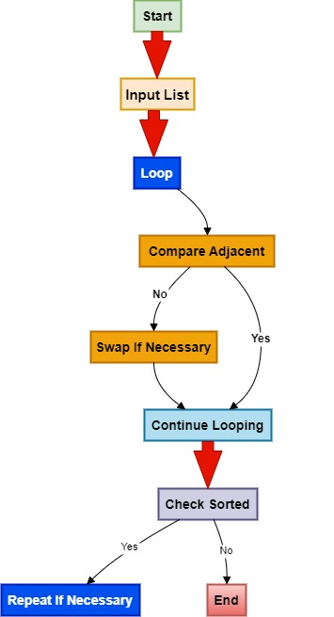
Bubble Sort

Slide 3
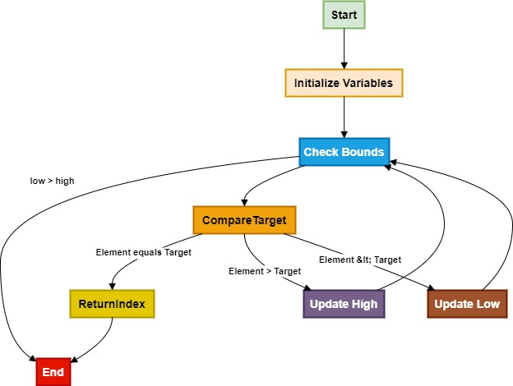
Binary Search

Slide 4
Thank you
G.Varun Teja
227Z5A6603
CSE-AIML

